Slide 1
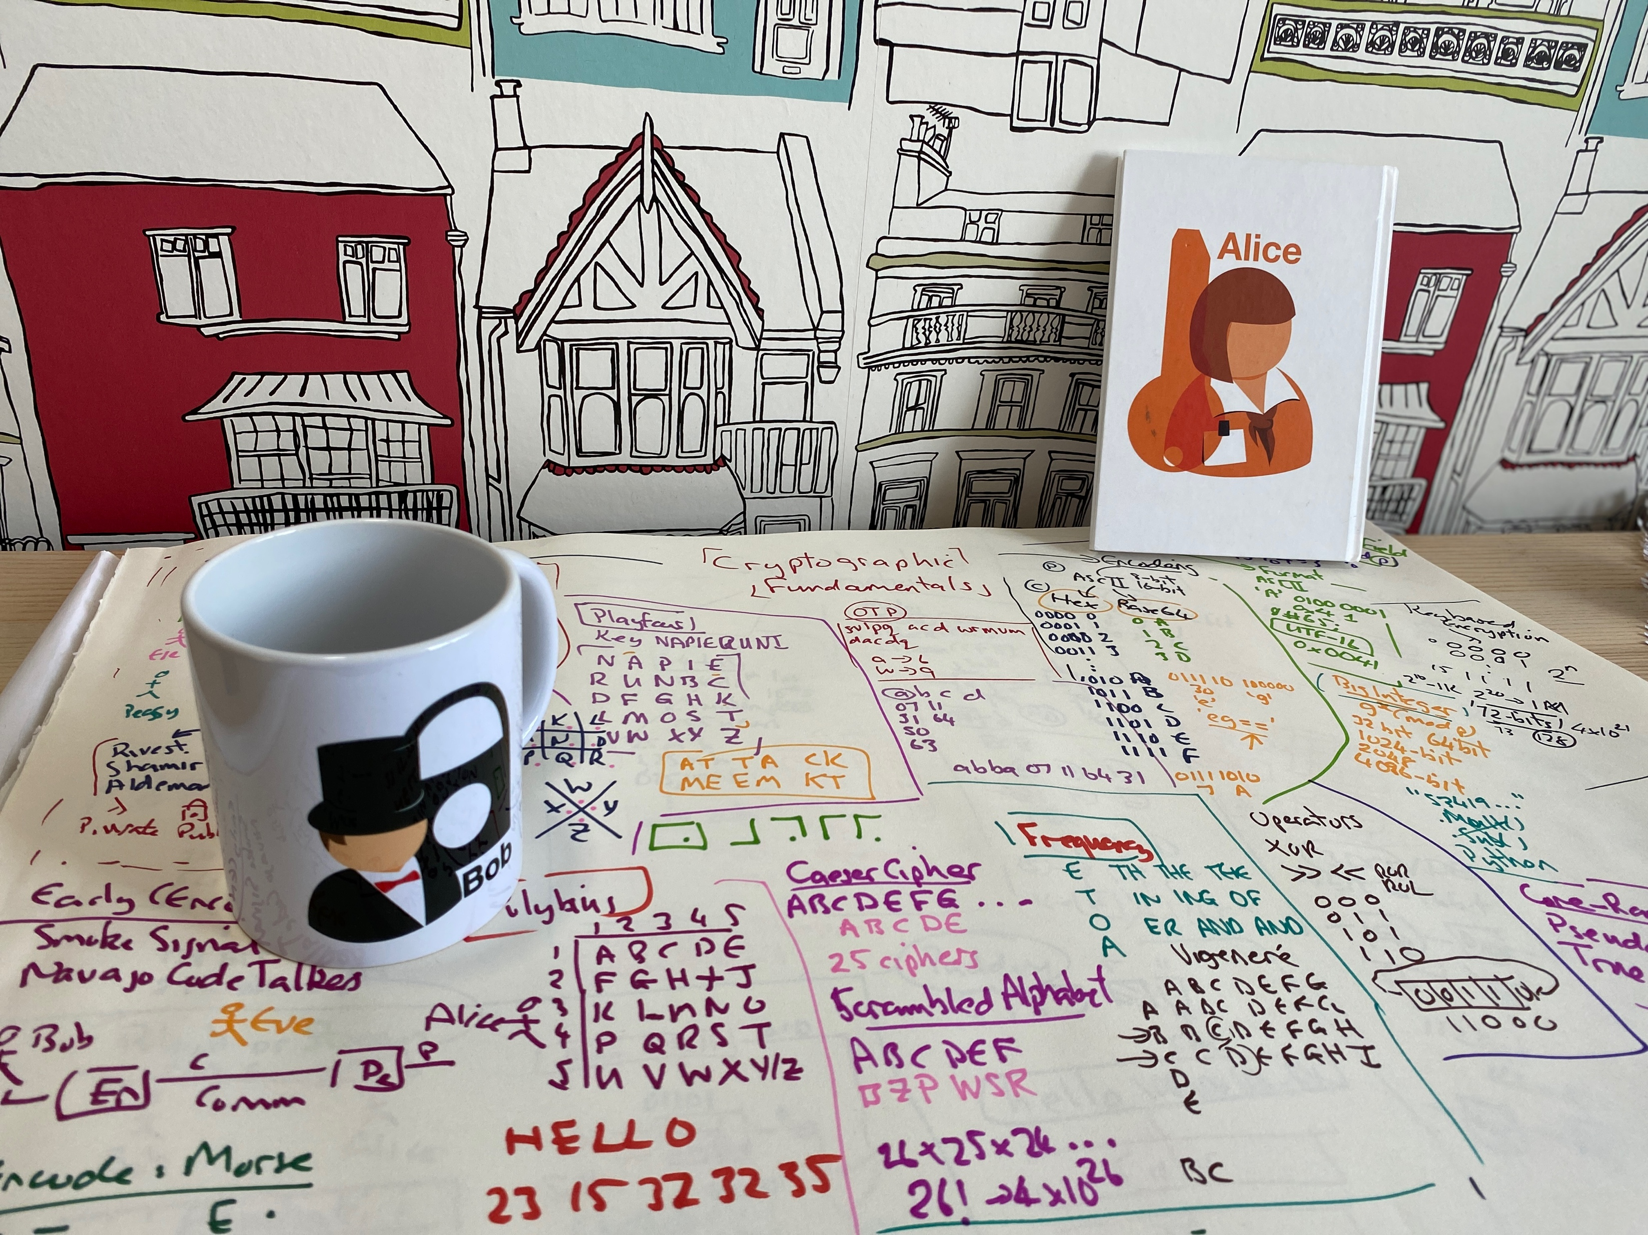
Next Generation Crypto
Light-weight crypto.
Quantum-robust crypto
Tokenization.
Zero-knowledge.
Homomorphic Encryption.
zkSnarks, Range-proofs
Prof Bill Buchanan OBE https://asecuritysite.com/light

Slide 2
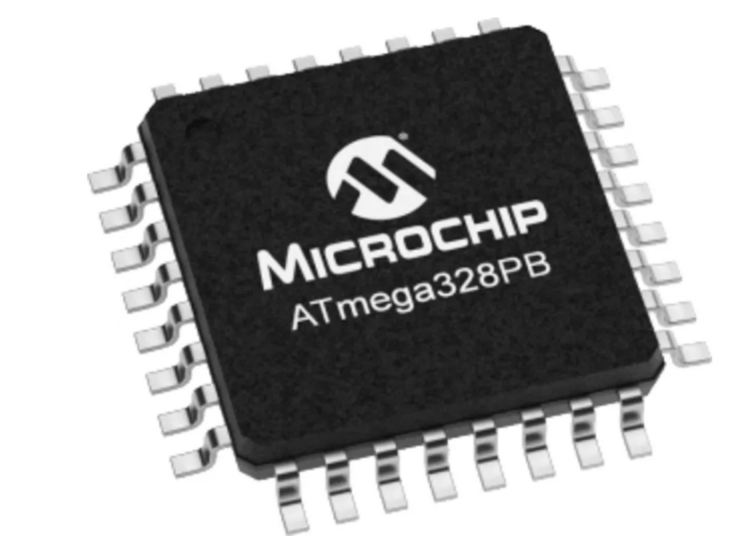
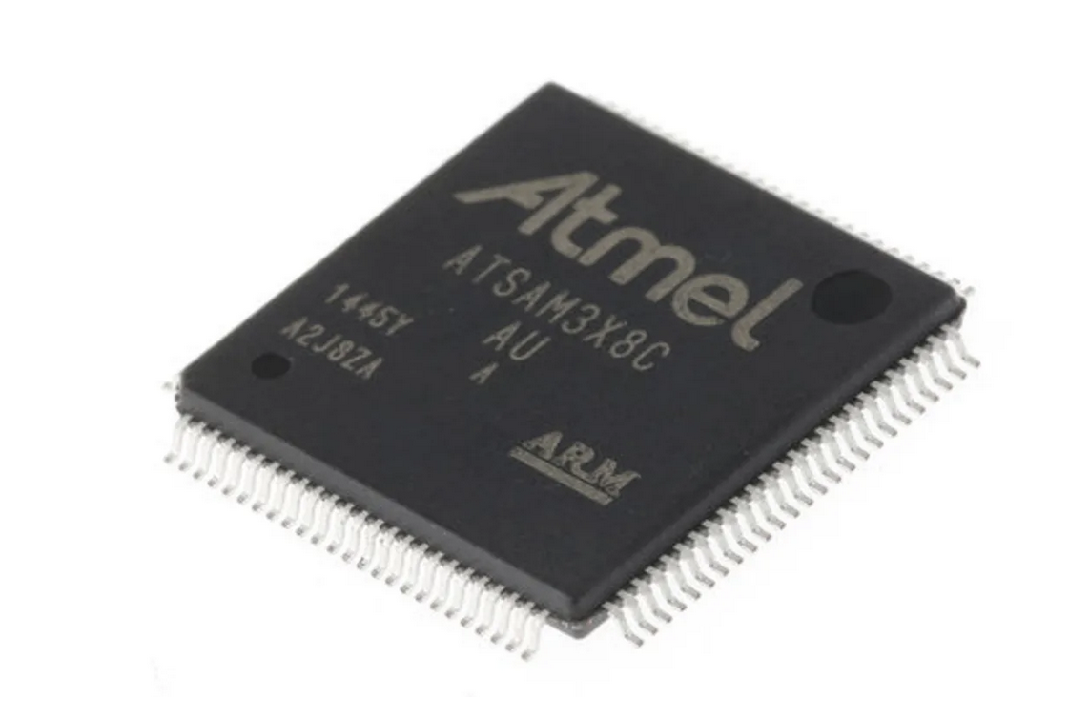
A Computer?

Slide 3


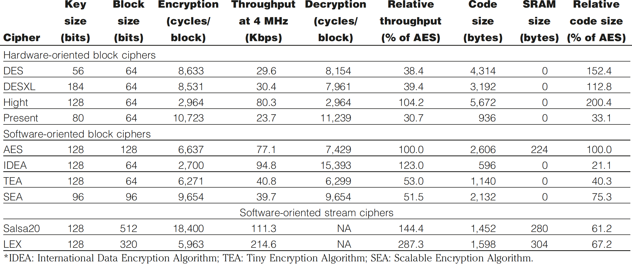
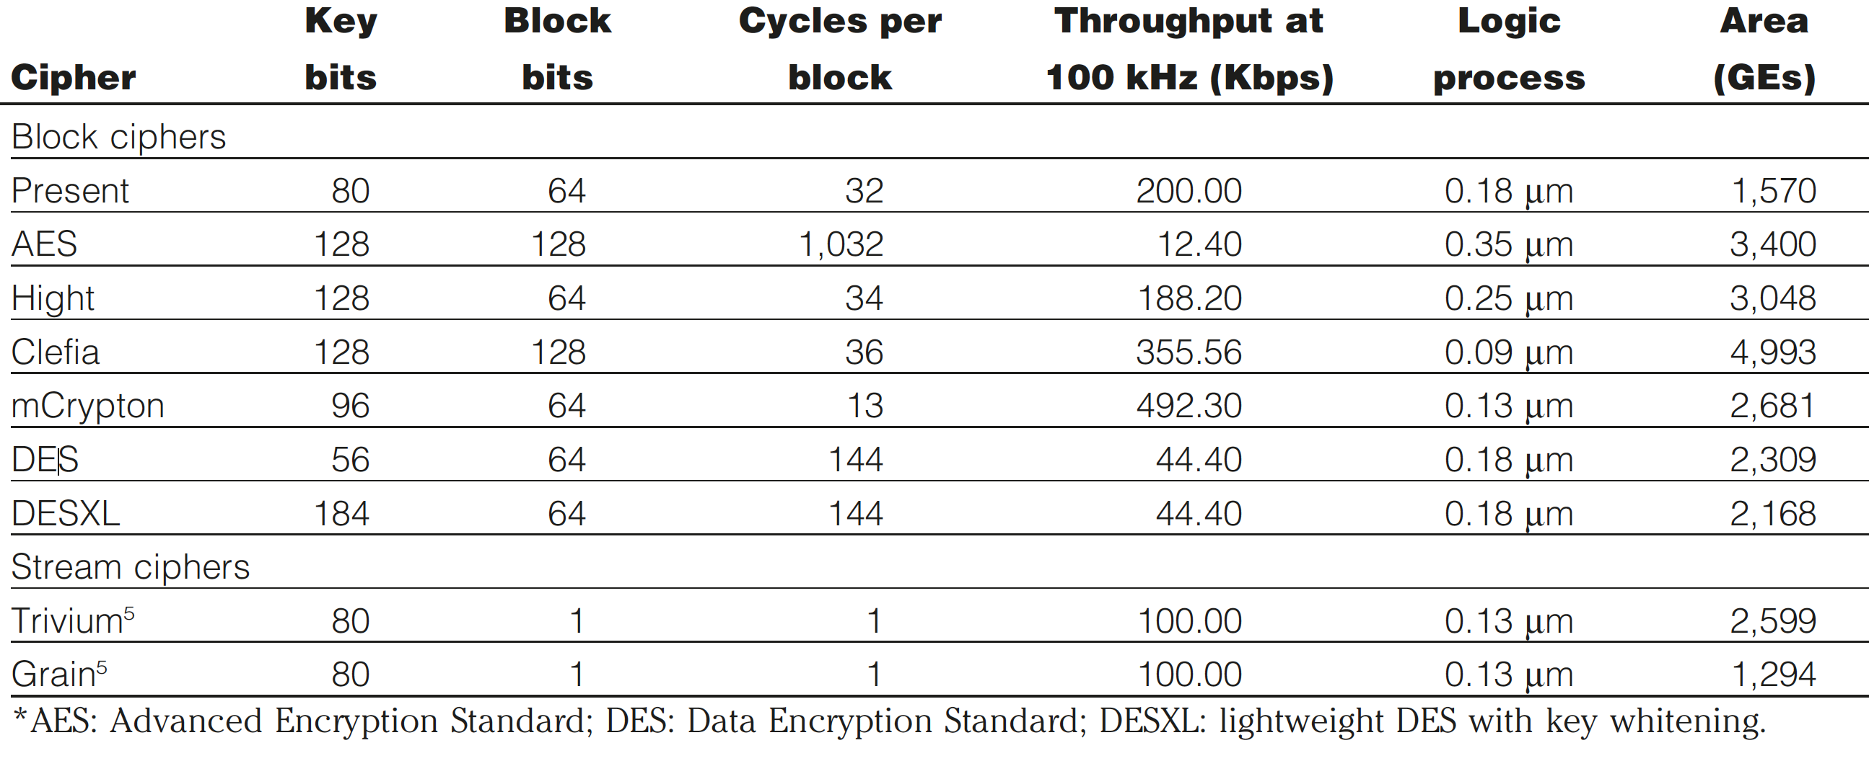
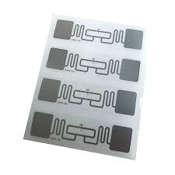
Light-weight crypto
Conventional cryptography. Servers and Desktops. Tablets and smart phones.
Light-weight cryptography. Embedded Systems. RFID and Sensor Networks.
Thus often light-weight cryptography methods balance performance (throughput) against power drain and GE (gate equivalents). Along with this the method must also have a low requirement for RAM (where the method requires the usage of running memory to perform its operation) and ROM (where the method is stored on the device). In order to assess the strengths of various methods we often define the area that the cryptography function will use on the device — and which is defined in µm².
View methods

Slide 4
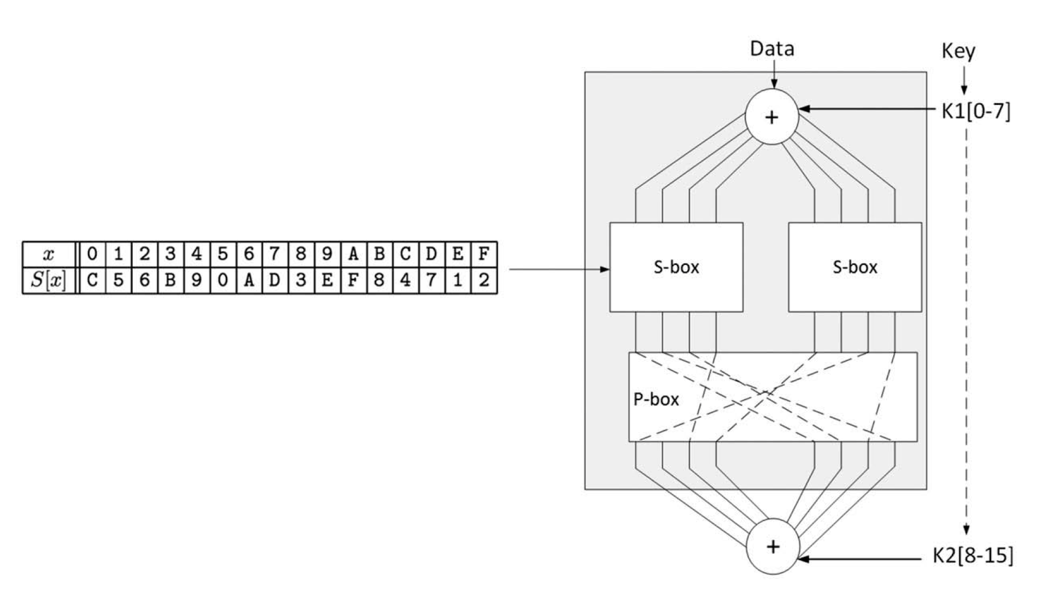
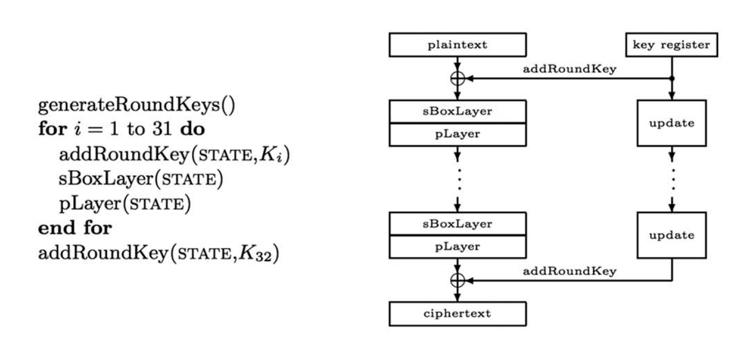
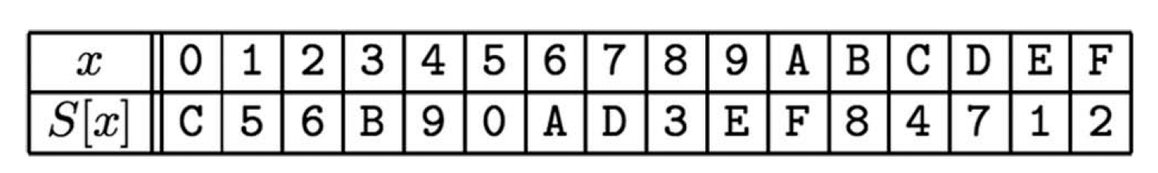
Light-weight crypto (PRESENT)
View methods

Slide 5
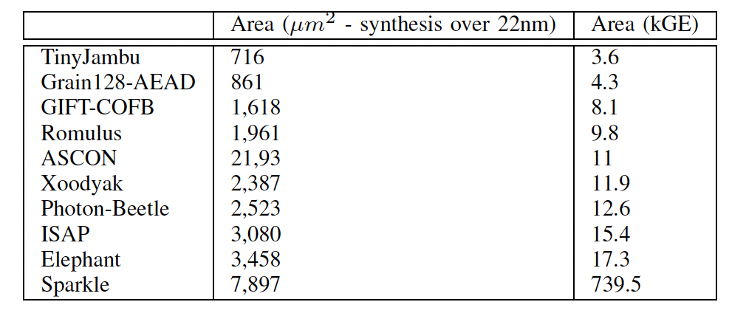
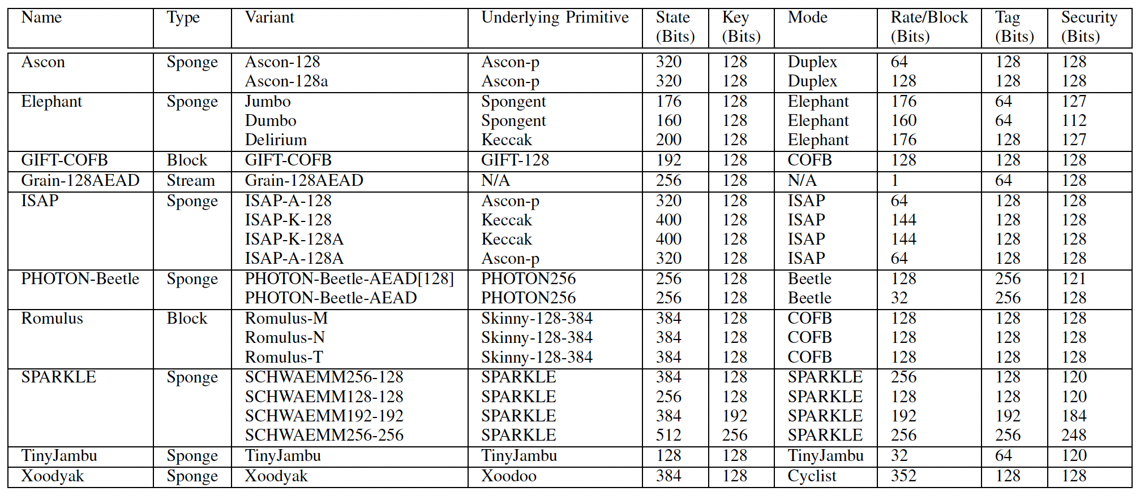
Light-weight crypto (Finalists)
Elsadek, S. Aftabjahani, D. Gardner, E. MacLean, J. R. Wallrabenstein, and E. Y. Tawﬁk, “Hardware and energy efﬁciency evaluation of nist lightweight cryptography standardization ﬁnalists,” in 2022 IEEE International Symposium on Circuits and Systems (ISCAS). IEEE, 2022, pp. 133–137.
H. Madushan, I. Salam, and J. Alawatugoda, “A review of the nist lightweight cryptography finalists and their fault analyses,” Electronics, vol. 11, no. 24, p. 4199, 2022.
View methods

Slide 6
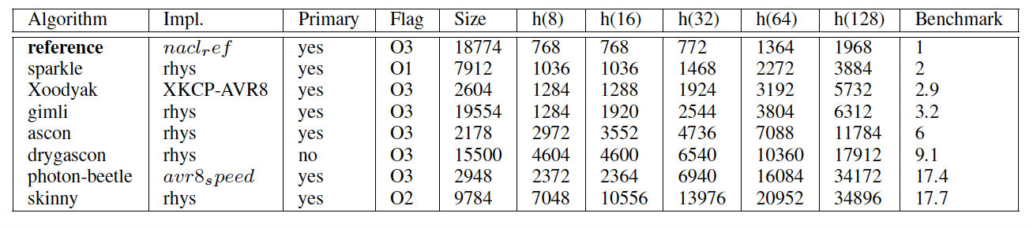
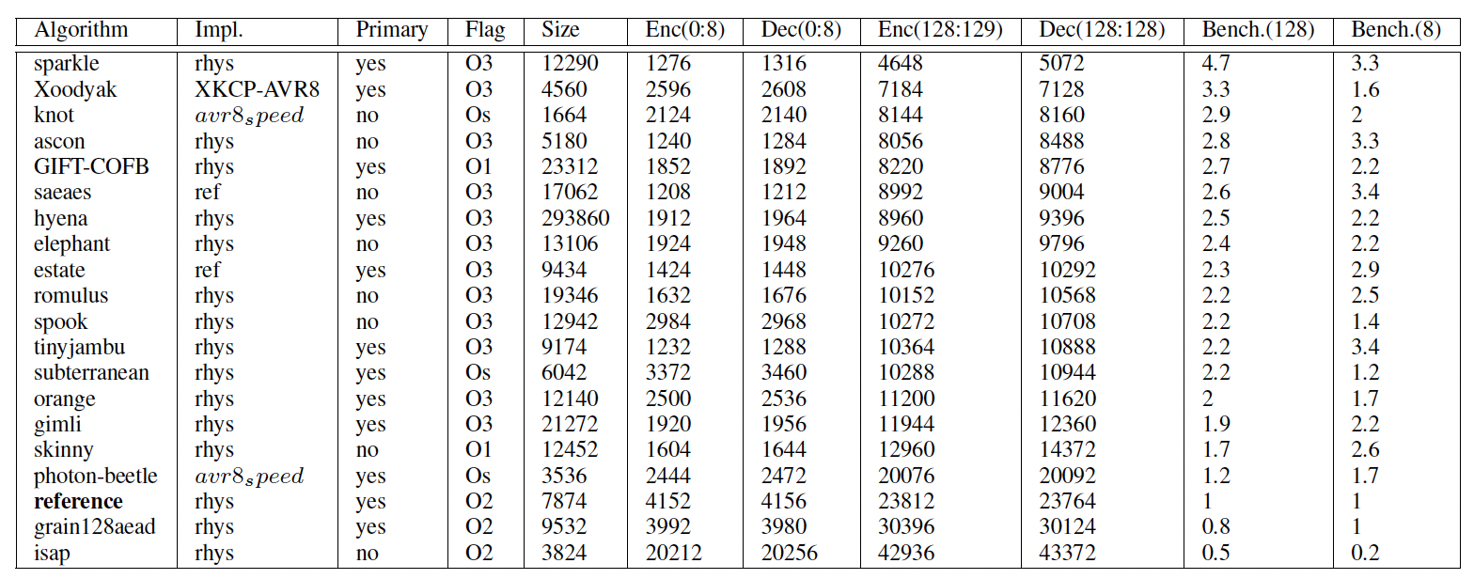
Light-weight crypto (Finalists)
View methods
E. Bellini and Y. J. Huang, “Randomness testing of the nist light weight cipher ﬁnalist candidates,” in NIST Lightweight Cryptography Workshop, May, 2022.

Slide 7
Next Generation Crypto
Light-weight crypto.
Quantum-robust crypto
Tokenization.
Zero-knowledge.
Homomorphic Encryption.
zkSnarks, Range-proofs
Prof Bill Buchanan OBE https://asecuritysite.com/pqc

Slide 8
Quantum-robust crypto
Lattice-based cryptography [Lattice] — This classification shows great potential and is leading to new cryptography methods, such as for fully homomorphic encryption, and code obfuscation.
Code-based cryptography [McEliece] — This classification was created in 1978 with the McEliece cryptosystem but has barely been using in real applications. The McEliece method uses linear codes that are used in error correcting codes, and involves matrix-vector multiplication. An example of a linear code is Hamming code.
Multivariate polynomial cryptography [UOV] — This classification involves the difficulty of solving systems of multivariate polynomials over finite fields. Unfortunately, many of the methods that have been proposed have already been broken.
Hash-based signatures [GMSS] — This classification involves creating digital signatures using hashing methods. The drawback is that a signer needs to keep a track of all of the messages that have been signed, and that there is a limit to the number of signatures that can be produced. New methods, though, integrate into Merkle Trees, which allows for the signer to use the same keys to sign multiple entities.

Slide 9
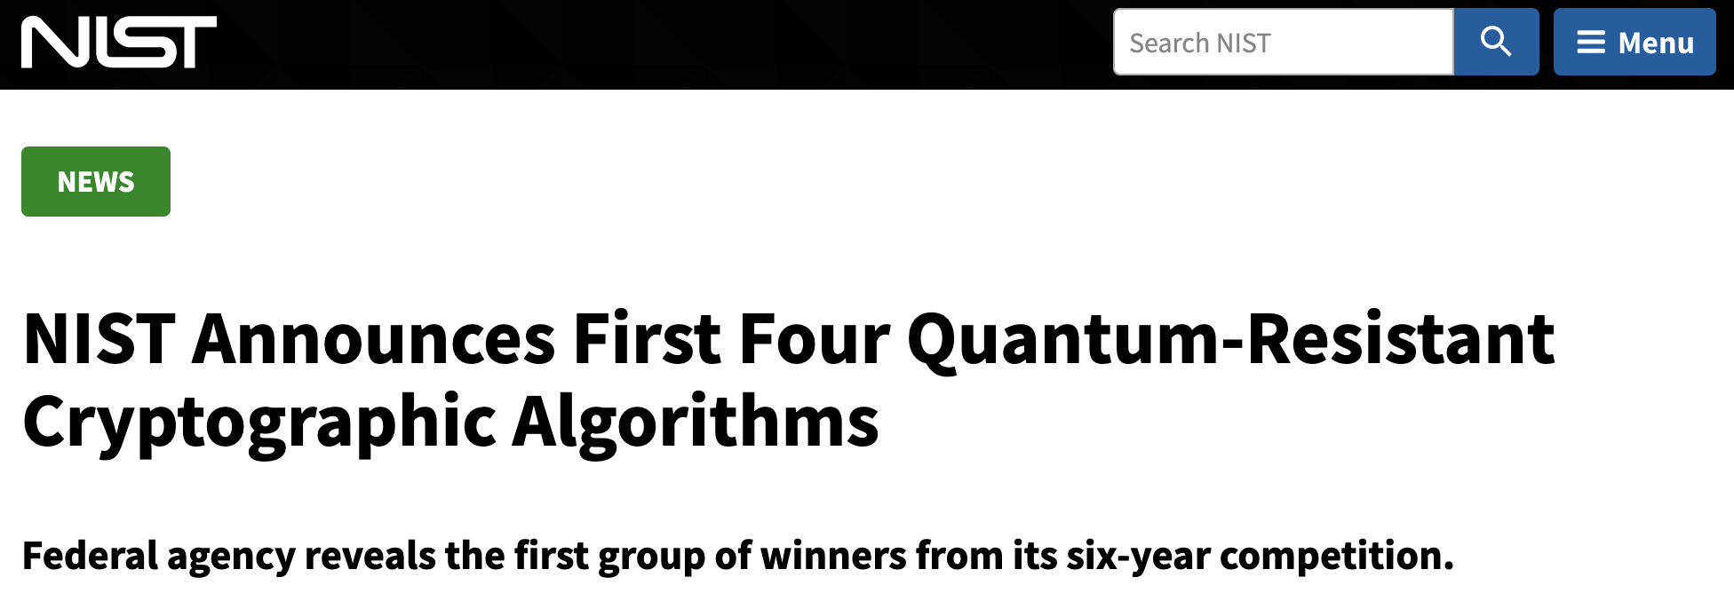
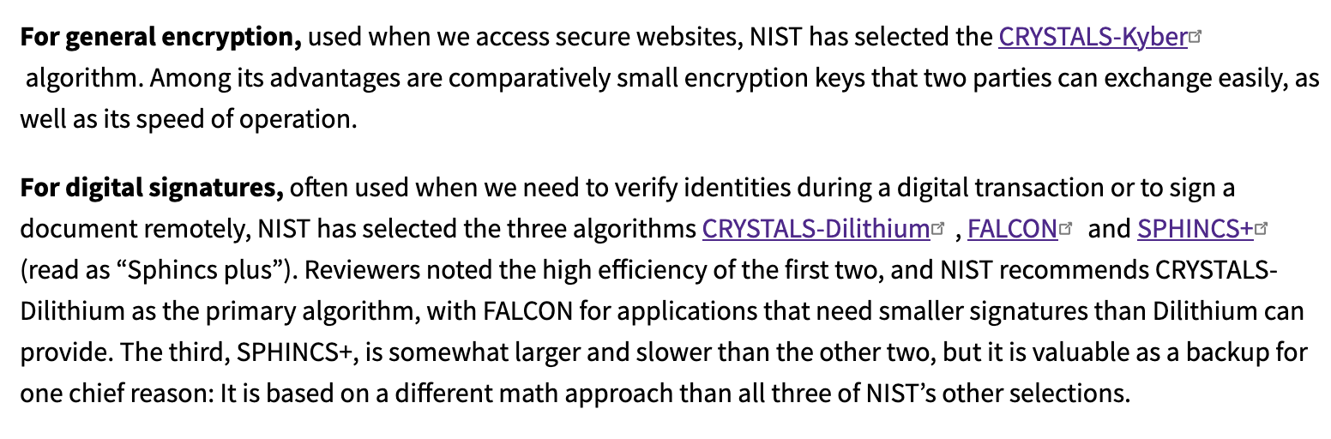
Quantum-robust crypto

Slide 10
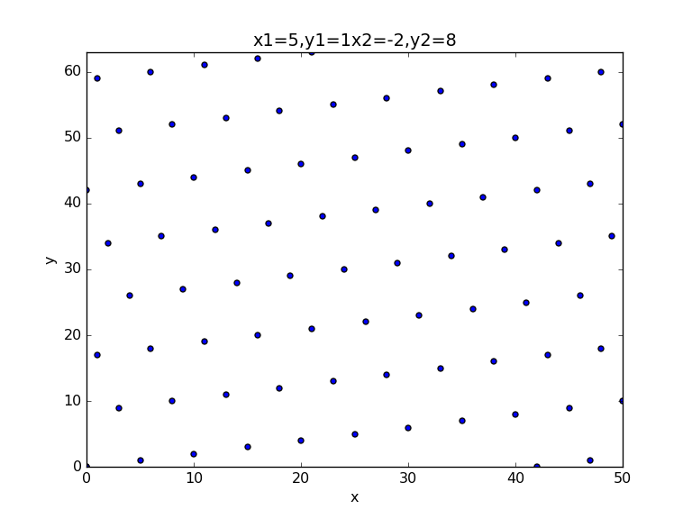
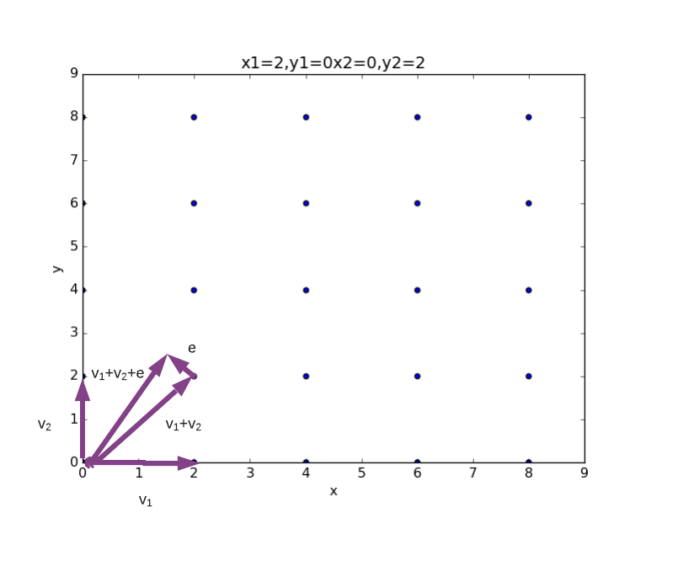
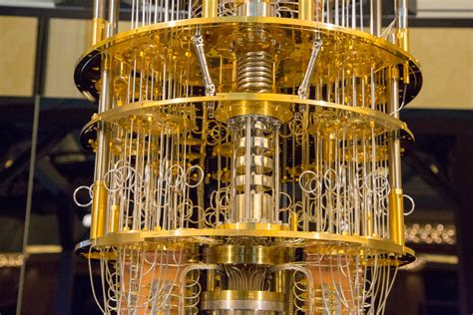
PQC Robust Crypto - Lattice
Short Vector Problem and Closest Vector Problem

Slide 11
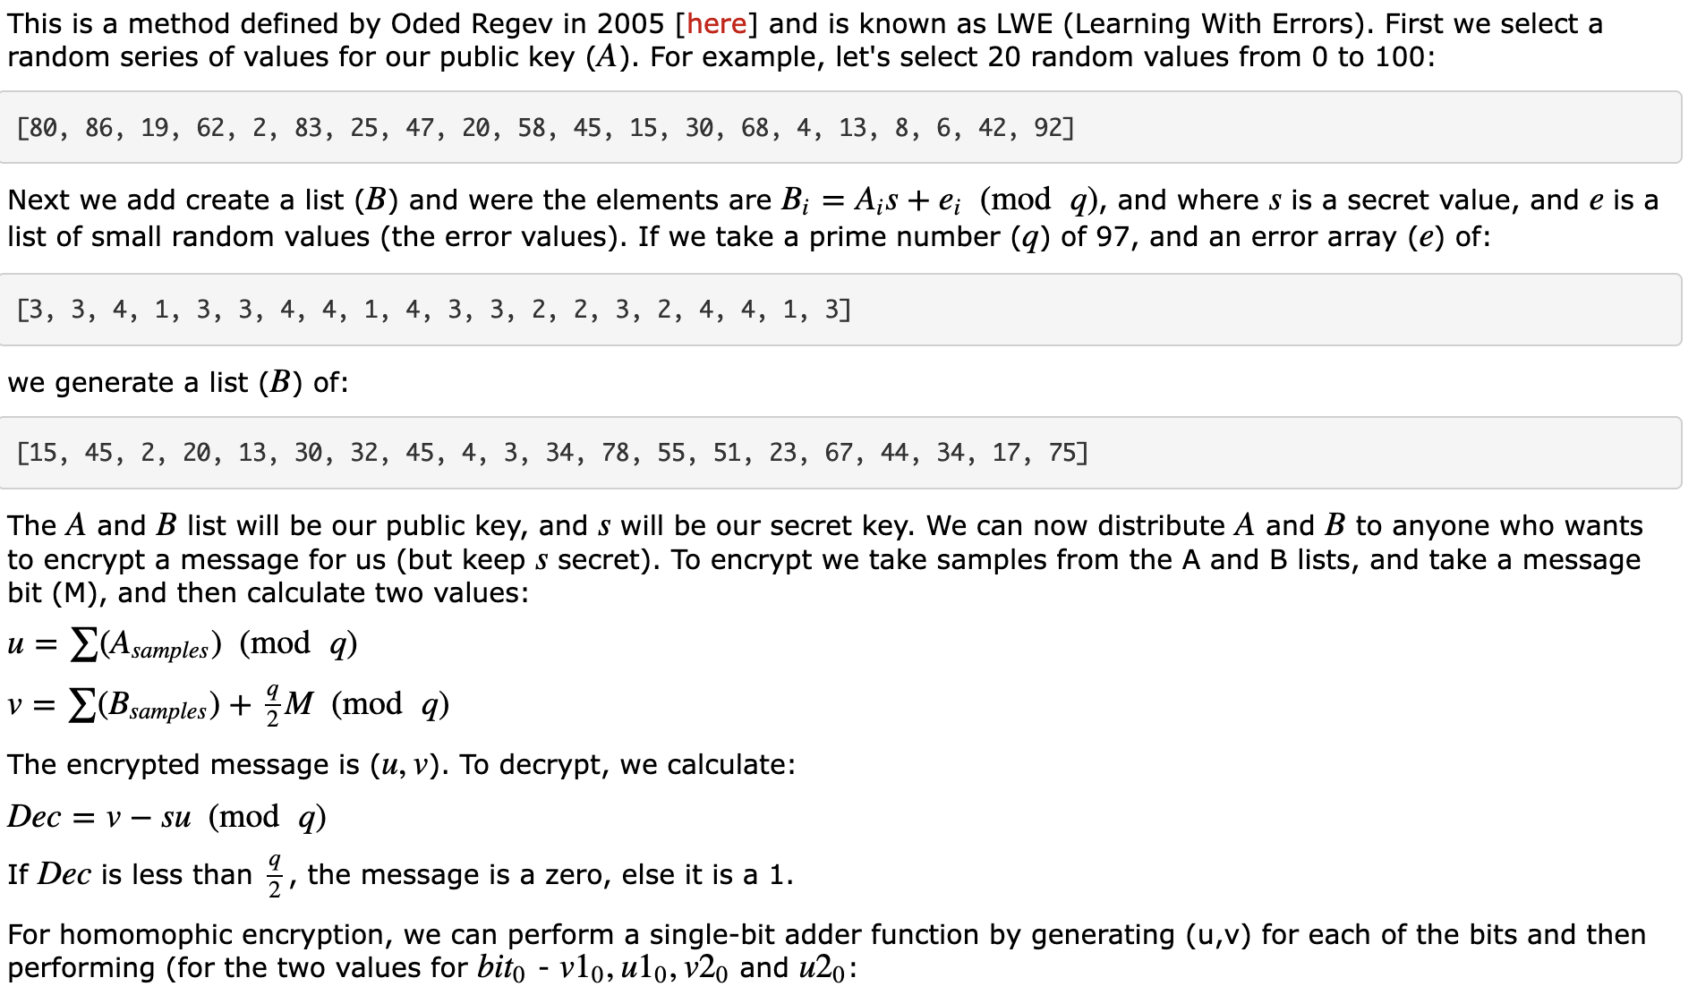
PQC Robust Crypto – Lattice Methods (LWE)

Slide 12
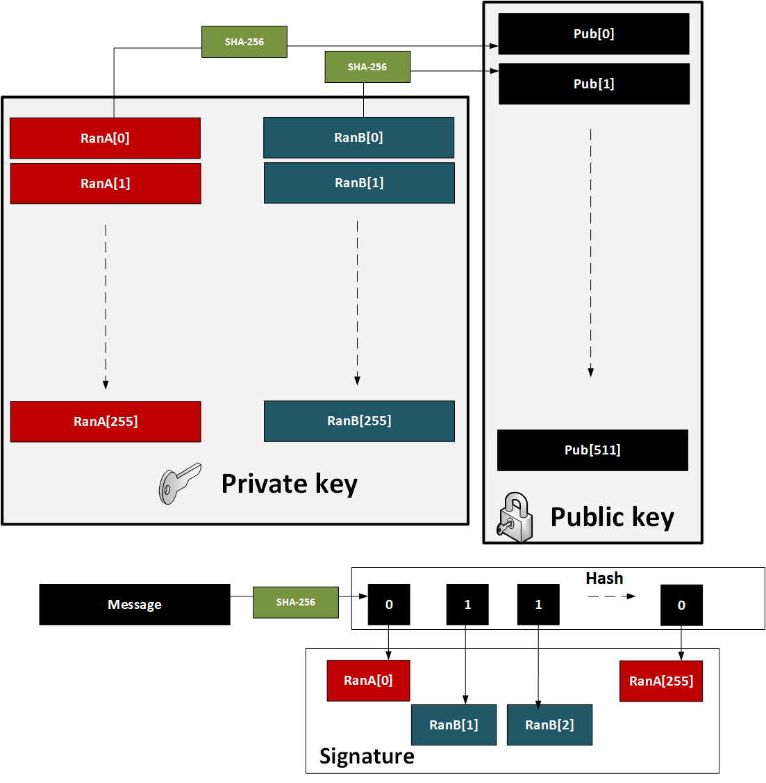
PQC Robust Crypto – Hash-based (Lamport)

Slide 13
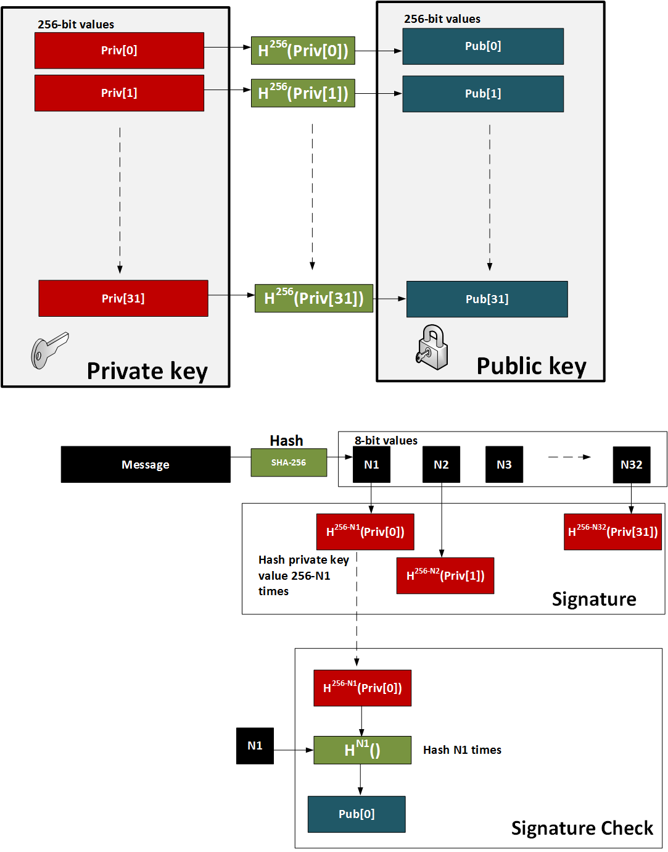
PQC Robust Crypto – Hash-based (W-OTS)

Slide 14
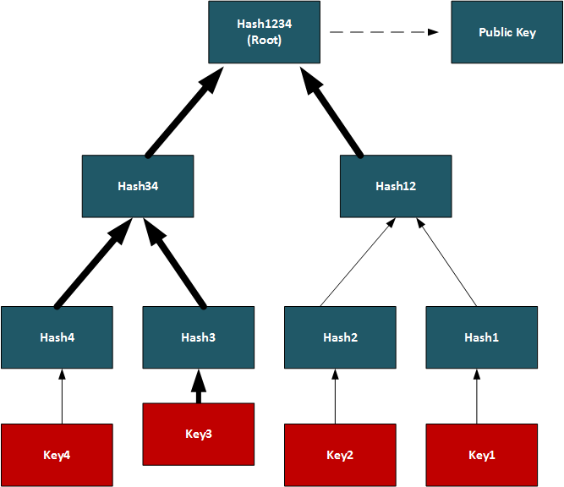
PQC Robust Crypto – Merkle signature scheme (MSS)

Slide 15
Next Generation Crypto
Light-weight crypto.
Quantum-robust crypto
Tokenization.
Zero-knowledge.
Homomorphic Encryption.
zkSnarks, Range-proofs
Prof Bill Buchanan OBE https://asecuritysite.com/tokens

Slide 16
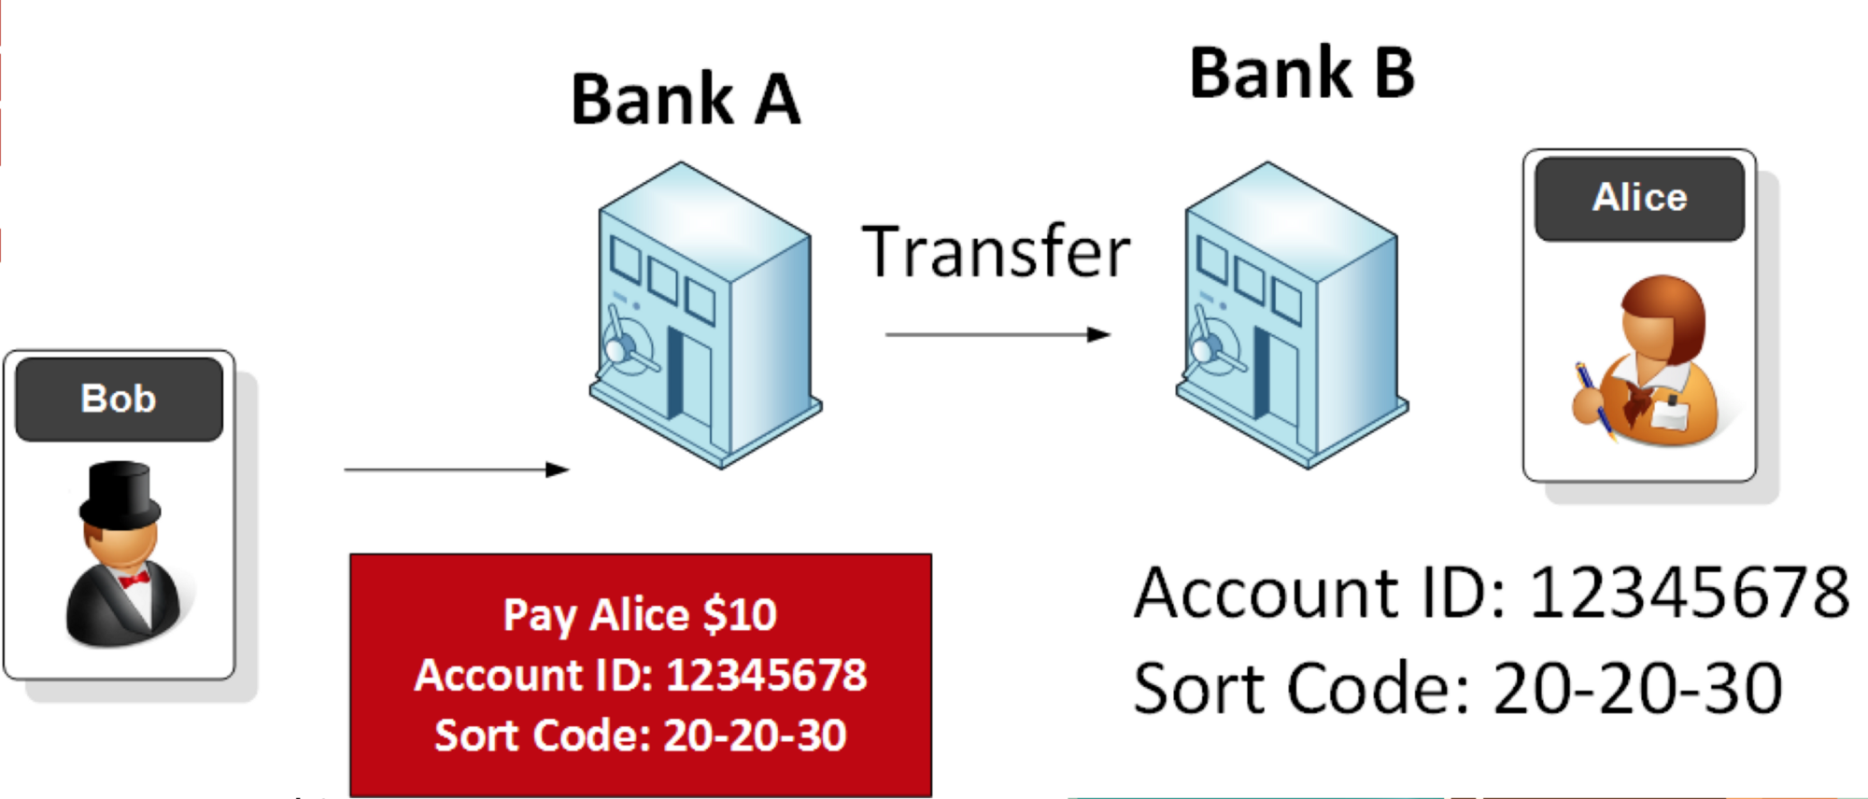

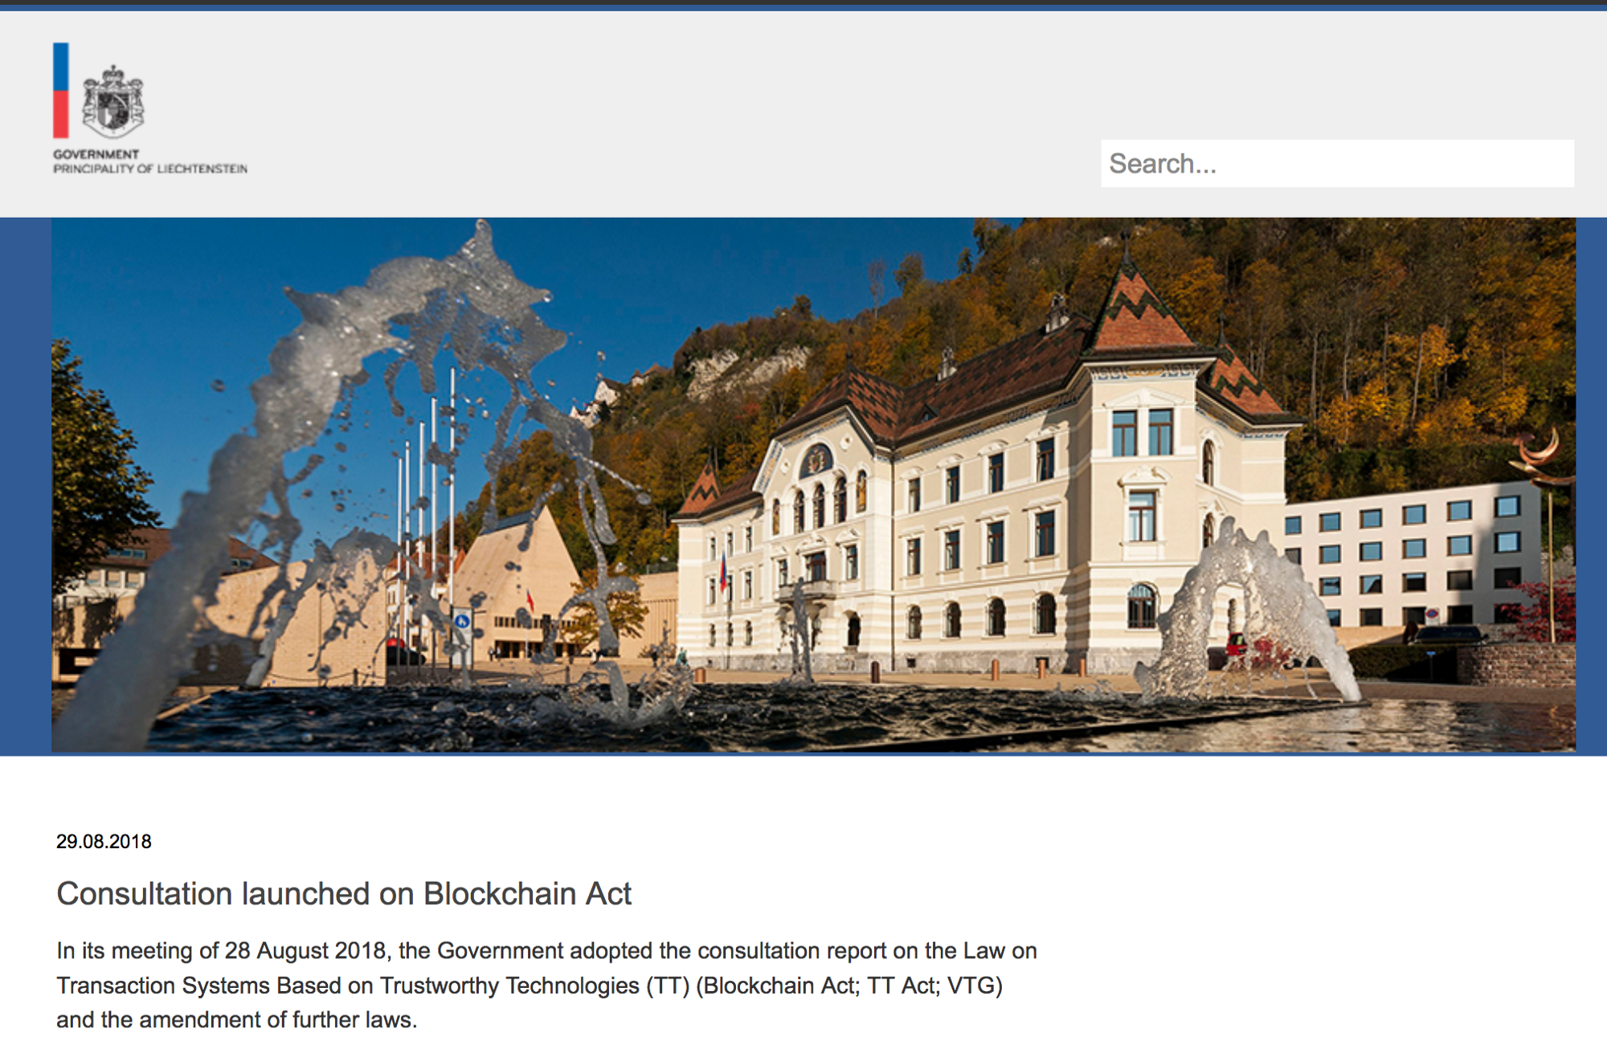

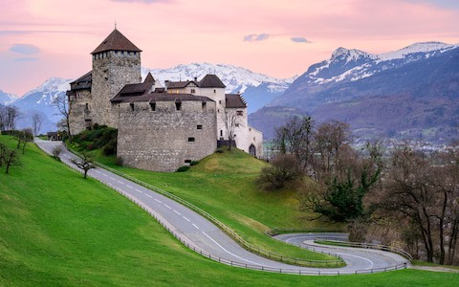
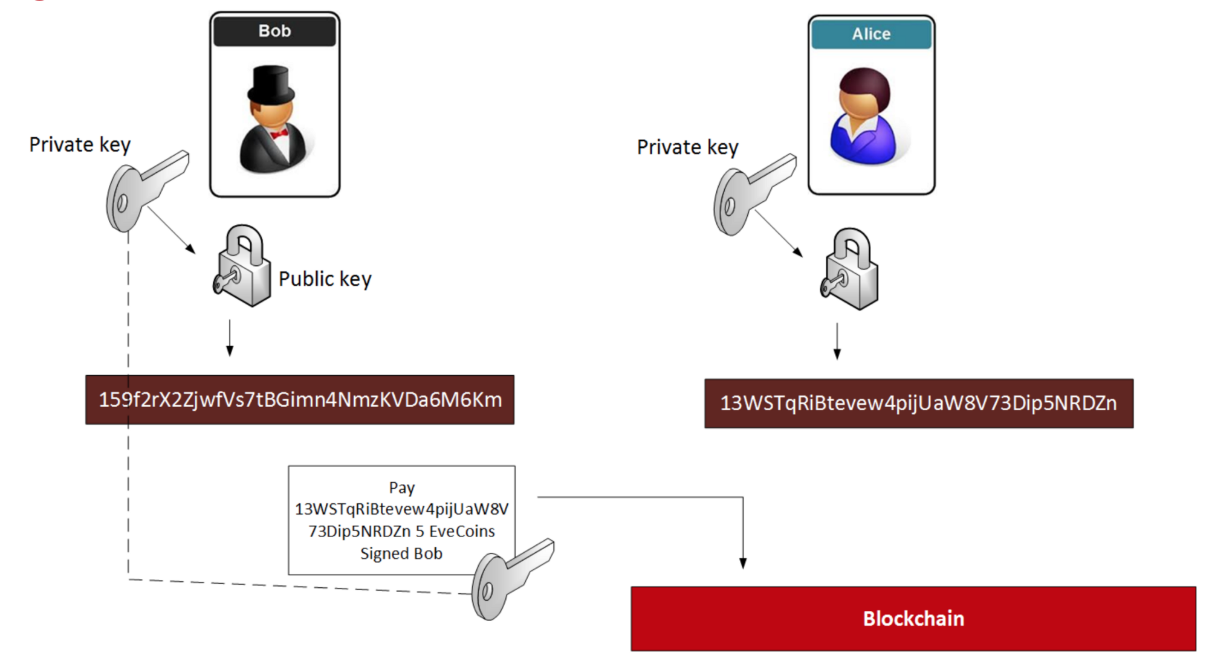

Blockchain Act
enable the transformation of the ‘real’ world to blockchain systems while ensuring legal certainty, thereby opening up the full application potential of the token economy.

Slide 17

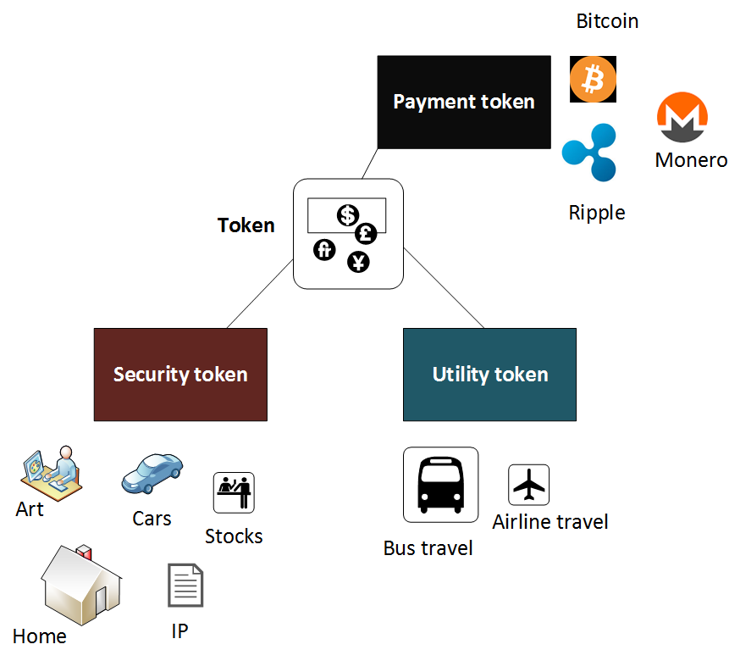

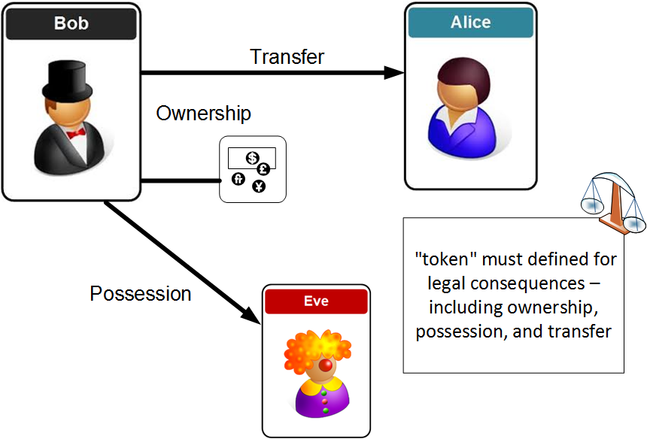

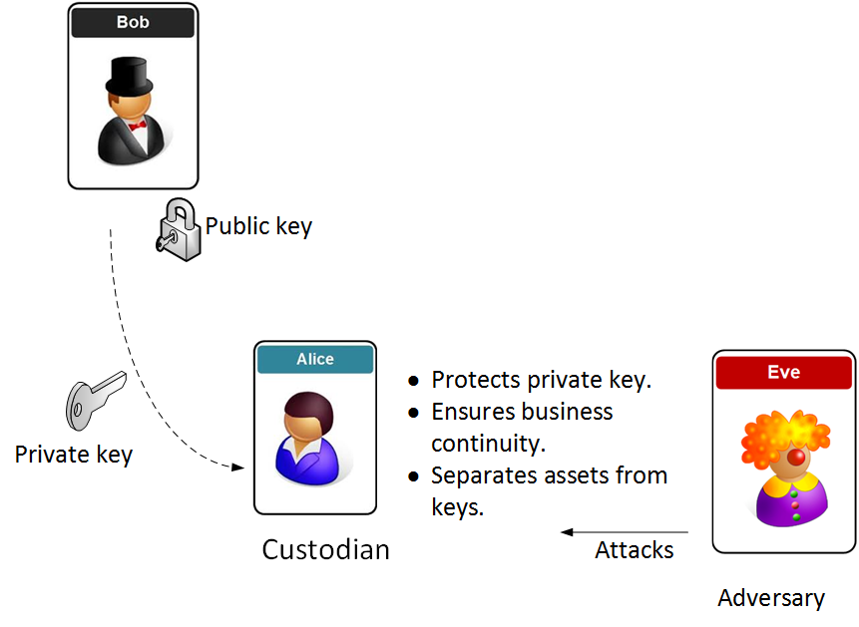
Blockchain Act
Subject and purpose (Art. 1 VE-VTG): This defines that the main focus is around the protection of users, and to thus build confidence in tokens.
Trusted technologies (Art. 3 VE-VTG): This defines the technology that is required to build a VT.
Definitions (Art. 5 VE-VTG): This defines a token as something that defines claims of a person to the rights to goods.
Rights of disposal (Art. 6 ff. VE-VTG): This defines the rights to transfer tokens, and is normally defined by the owner of a private key signing the transaction. A disposition is defined as the transfer of the disposition authorization on the token. Within the Act, it is defined that a buyer has the rights to dispose of a token, even if the seller was not authorized to dispose of the same token.
Requirements for VT service providers (Art. 13 ff. VE-VTG): This defines the entities who will perform services within the VT. These entities must provide an organisational structure, control mechanisms and a minimum amount of capital.
Basic information on the issuance of tokens (Art. 28 ff. VE-VTG): This defines the assurance in the issuing of tokens and their legal requirements. They must provide a minimum amount of information, such as the technology used, the purpose of the token, and any risks. There should be at least 10 years of issuance, and to also prevent token cloning, along with prevention of a token not being released with the same rights.
Obligation to register (Art. 36 ff. VE-VTG): This defines that service providers must register into the Financial Market Authority (FMA) before starting their commercial operation.
Supervision (Art. 42 ff. VE-VTG): This defines that the FMA implements the Act.
Penal provisions (Art. 49 ff. VE-VTG)

Slide 18
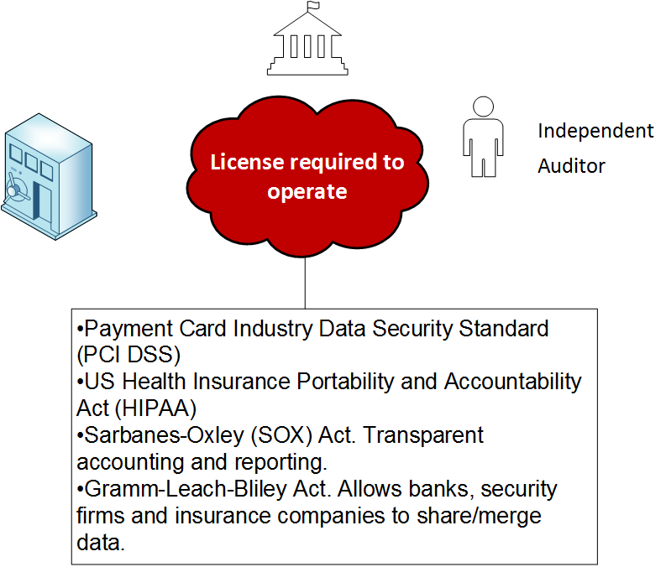

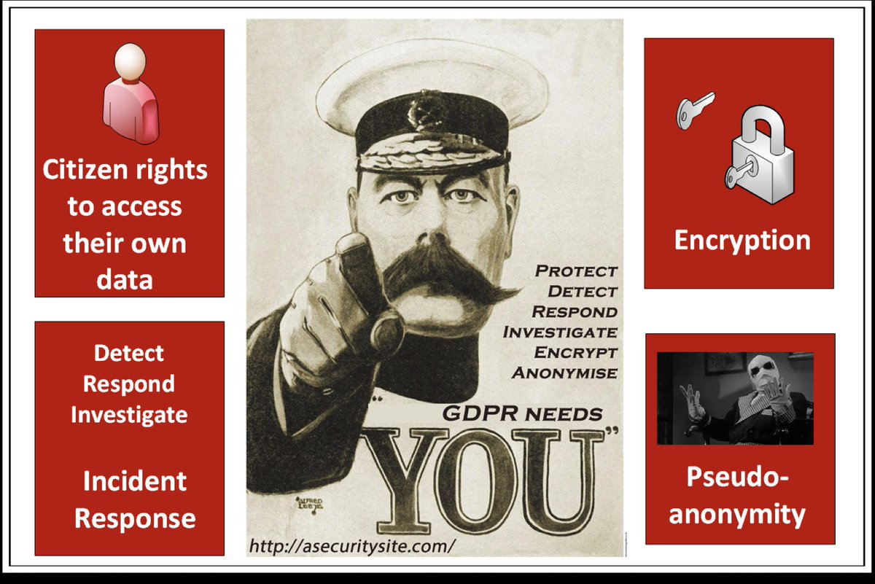
Audit Compliance

Slide 19
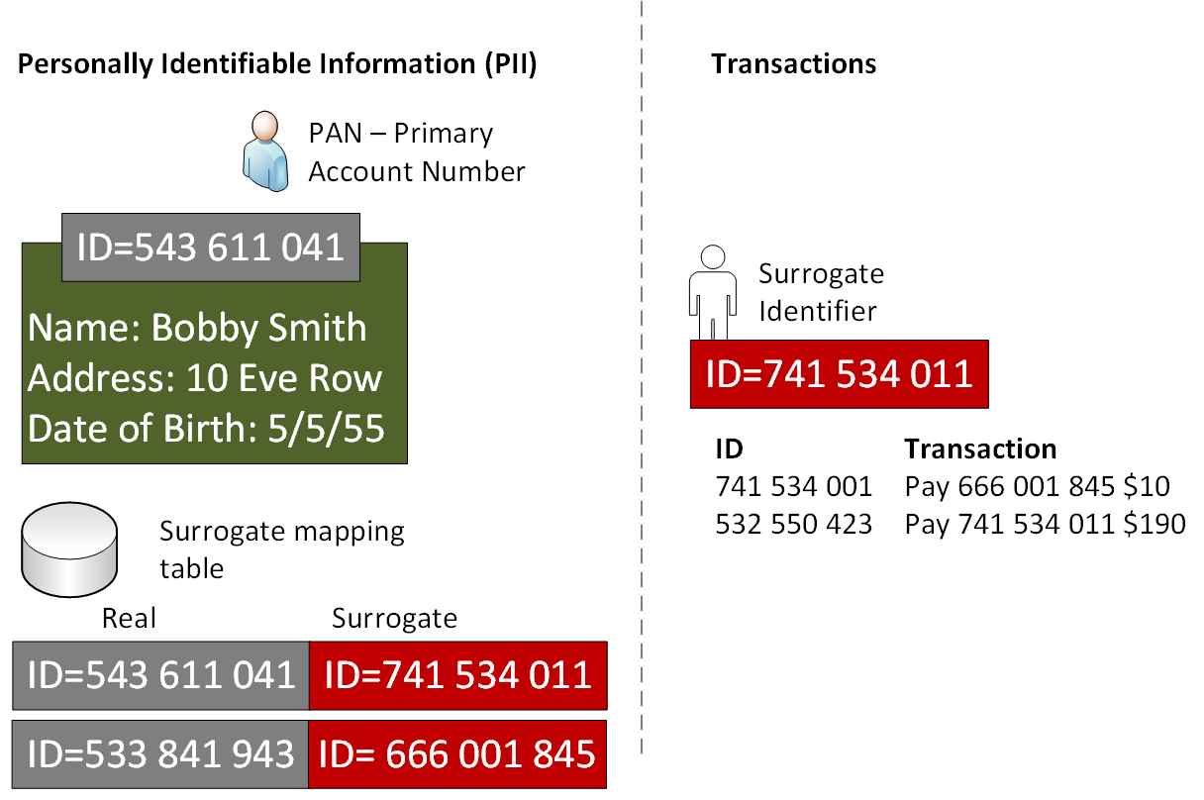
Surrogate identifiers

Slide 20
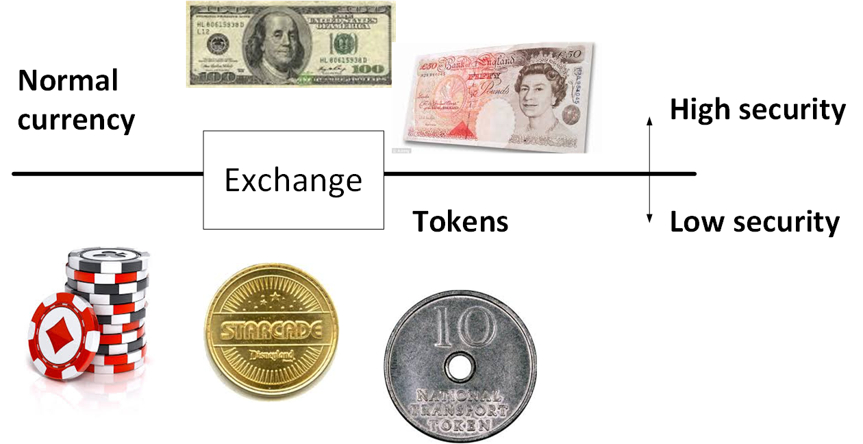
Tokenization with currency

Slide 21
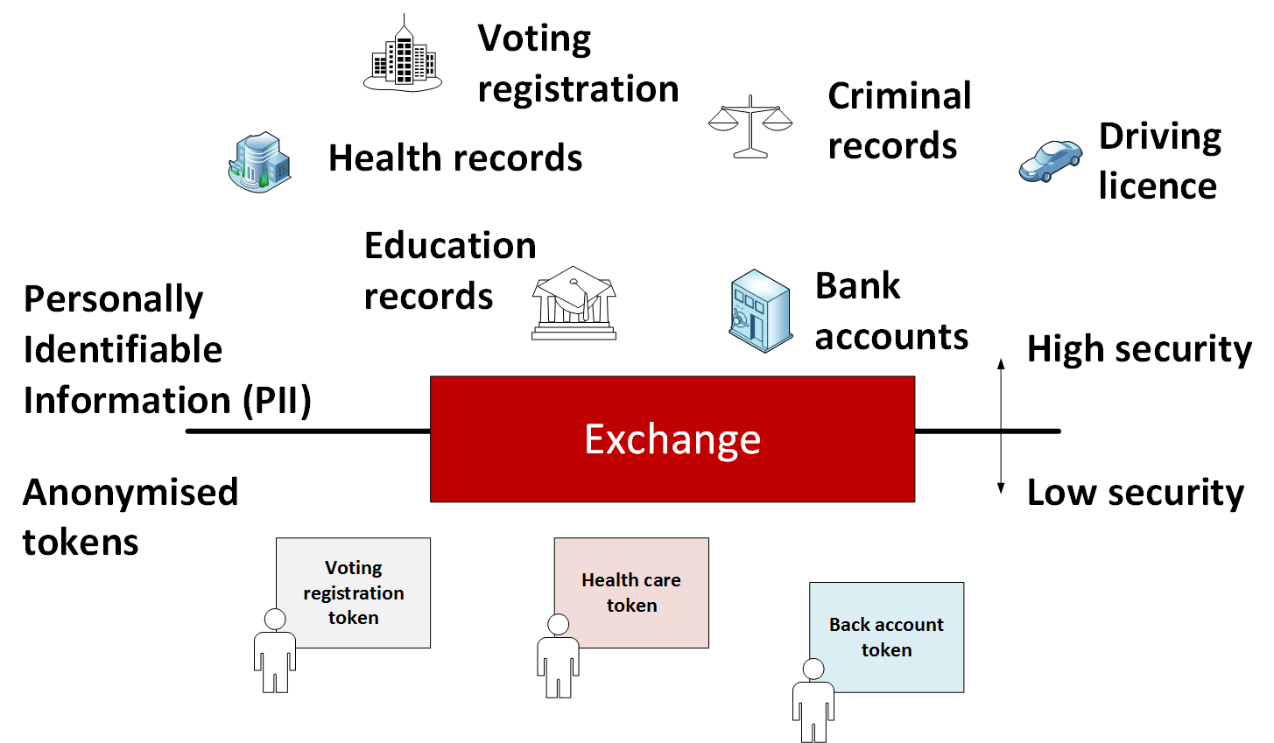
Tokenization with data

Slide 22
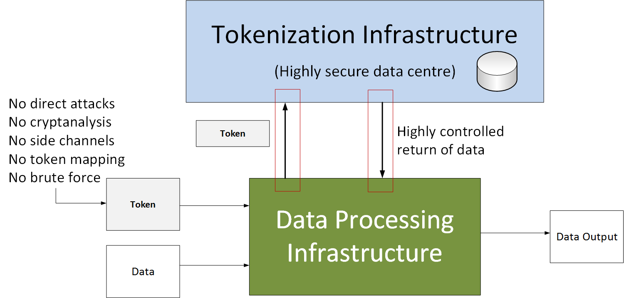
Tokenization with data

Slide 23
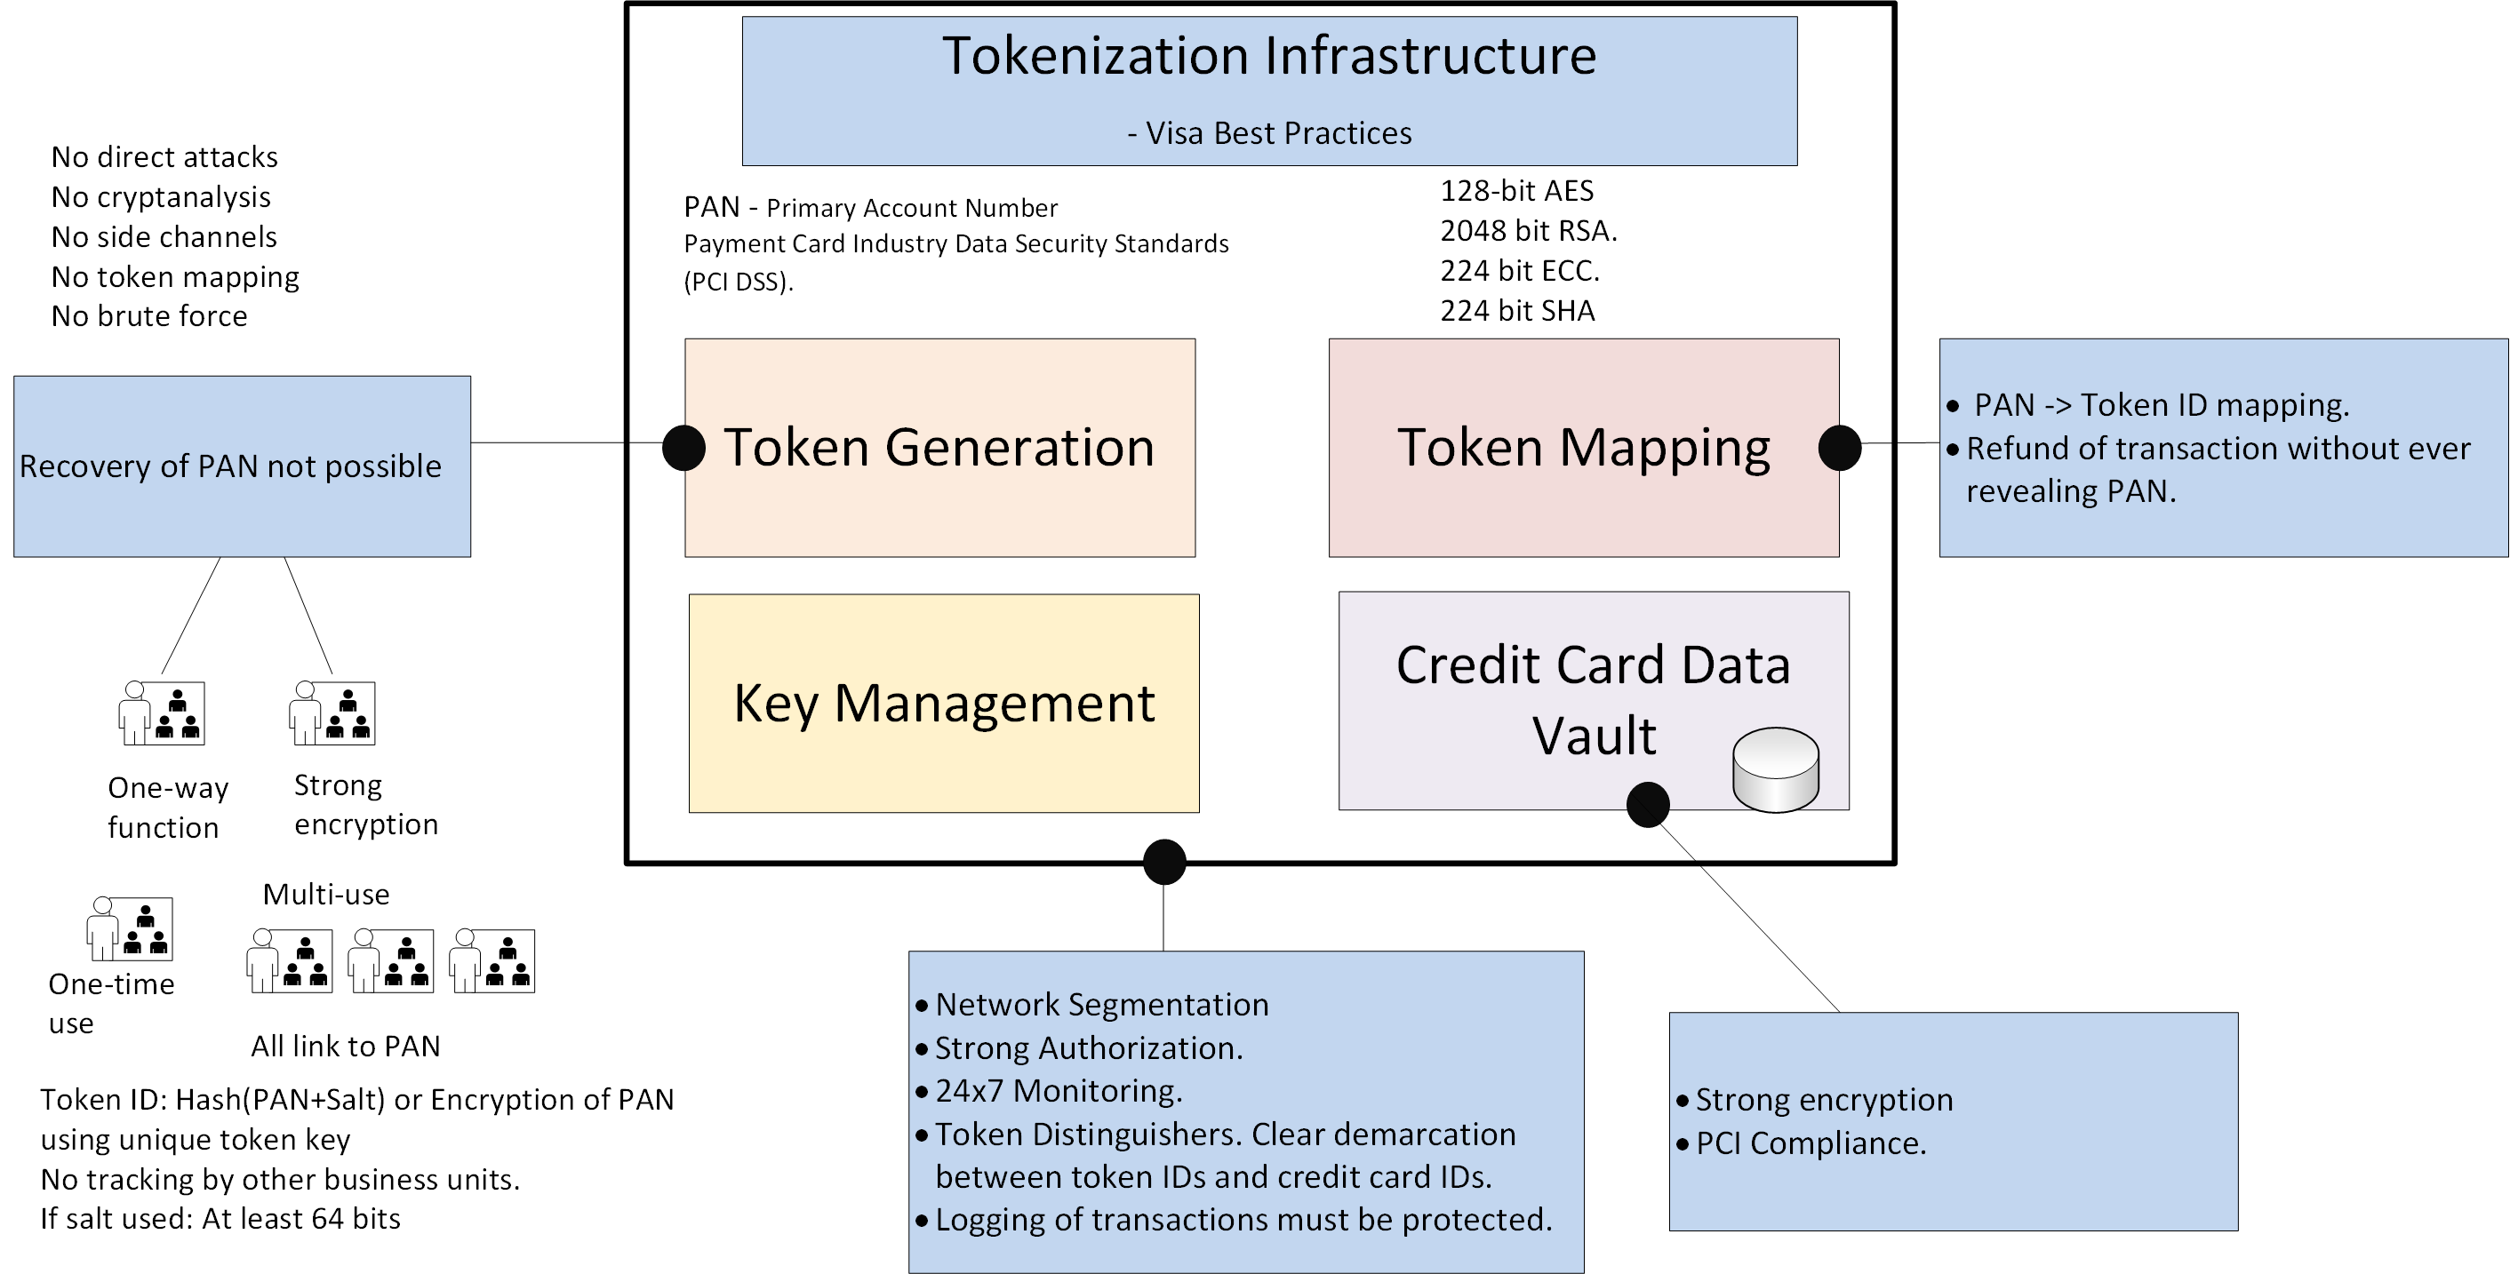
Visa Best Practice for Tokenization

Slide 24
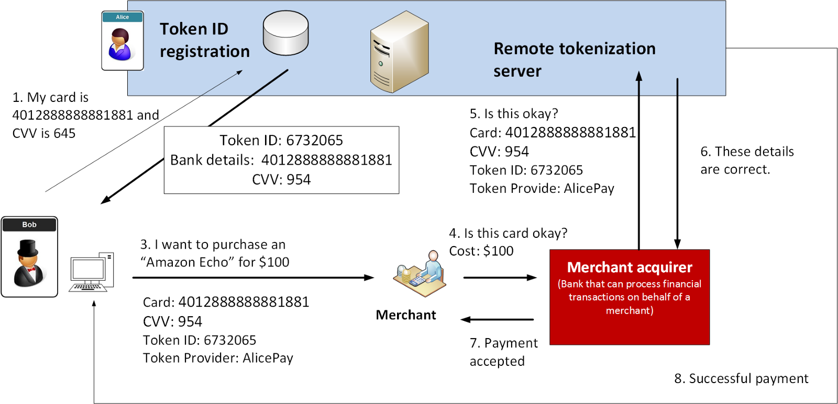
Token Mapping

Slide 25
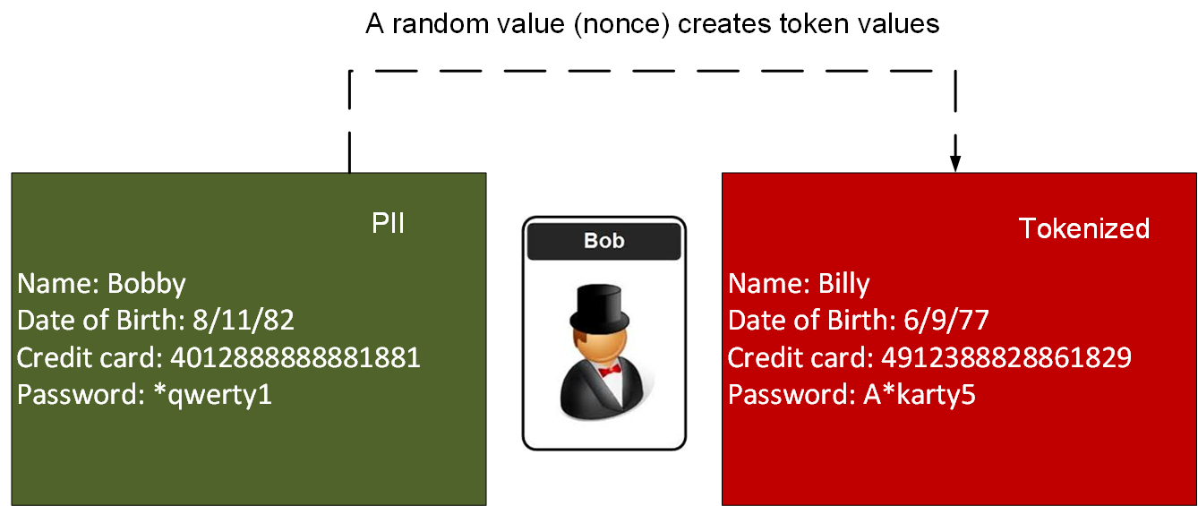
Token Mapping

Slide 26
Next Generation Crypto
Light-weight crypto.
Quantum-robust crypto
Tokenization.
Zero-knowledge.
Homomorphic Encryption.
zkSnarks, Range-proofs
Prof Bill Buchanan OBE http://asecuritysite.com/zero

Slide 27
Zero-knowledge Proof
Peggy is the prover.
Victor is the verifier.
Ali Baba - poor woodcutter - discovers the secret of a thieves as “open sesame”

Slide 28



Zero Knowledge Proof: Fiat-Shamir

Slide 29
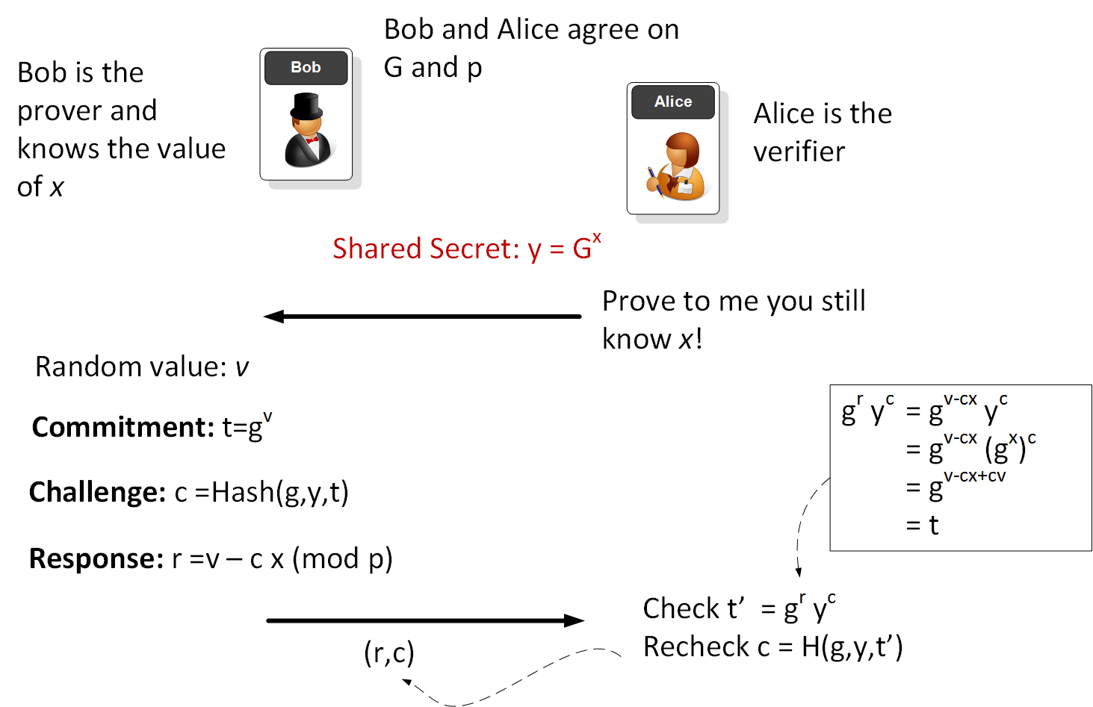
Bob proves and Alice verifies - Non-interactive random oracle access

Slide 30
Next Generation Crypto
Light-weight crypto.
Quantum-robust crypto
Tokenization.
Zero-knowledge.
Homomorphic Encryption.
zkSnarks, Range-proofs
Prof Bill Buchanan OBE http://asecuritysite.com/homomorphic

Slide 31
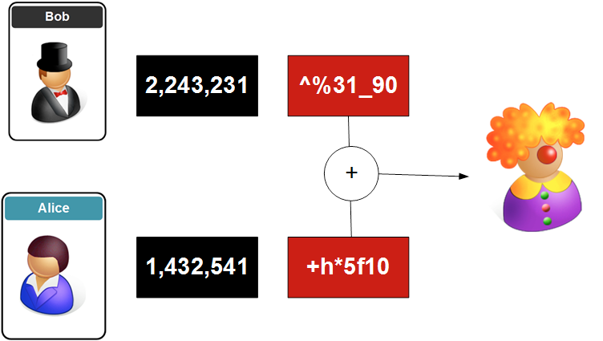
Homomorphic Encryption

Slide 32
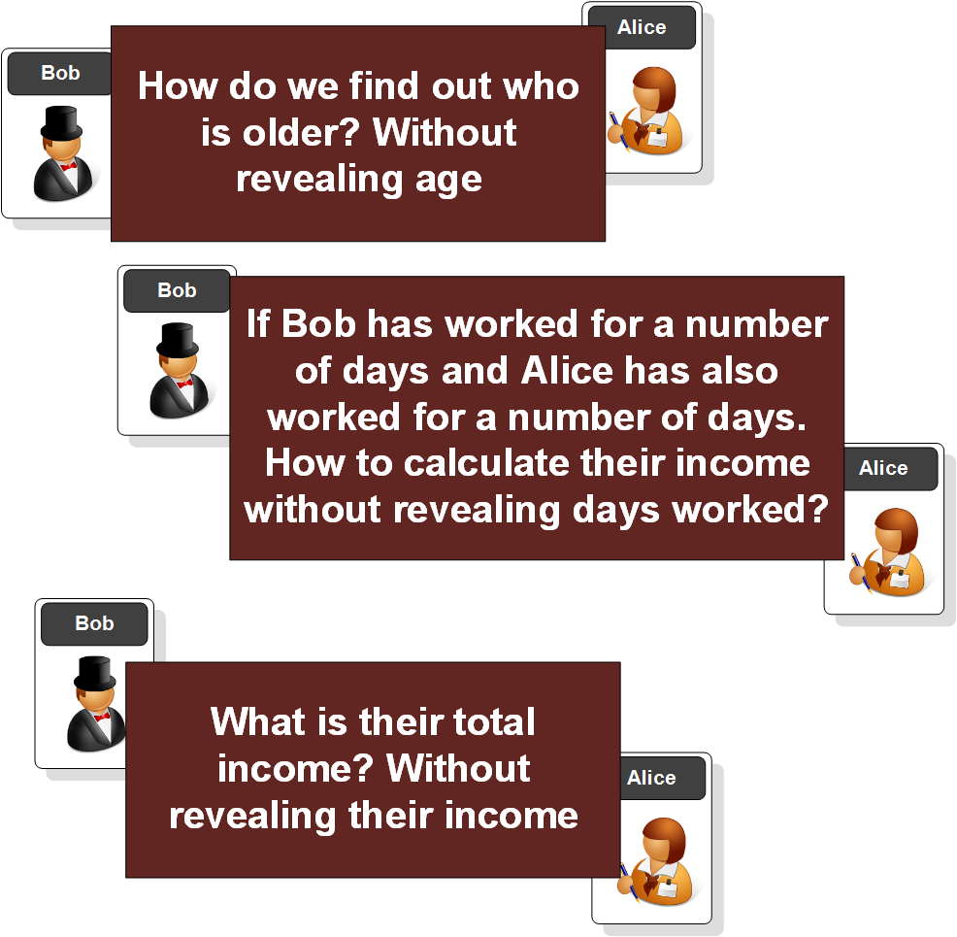
Homomorphic Encryption

Slide 33
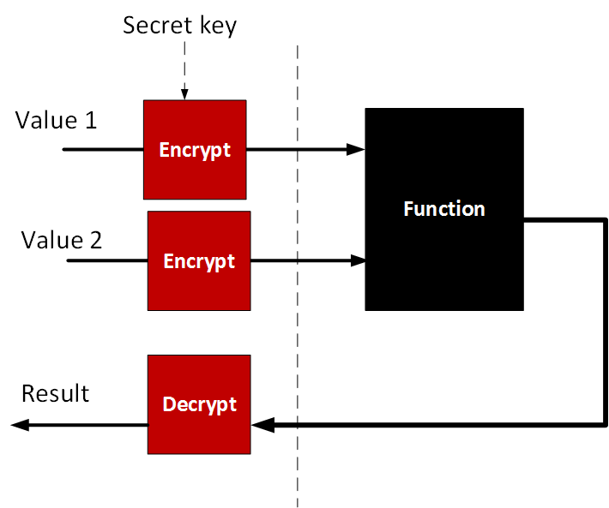
Full Homomorphic Encryption - DGHV (Dijk, Gentry, Halevi and Vaikuntanathan

Slide 34
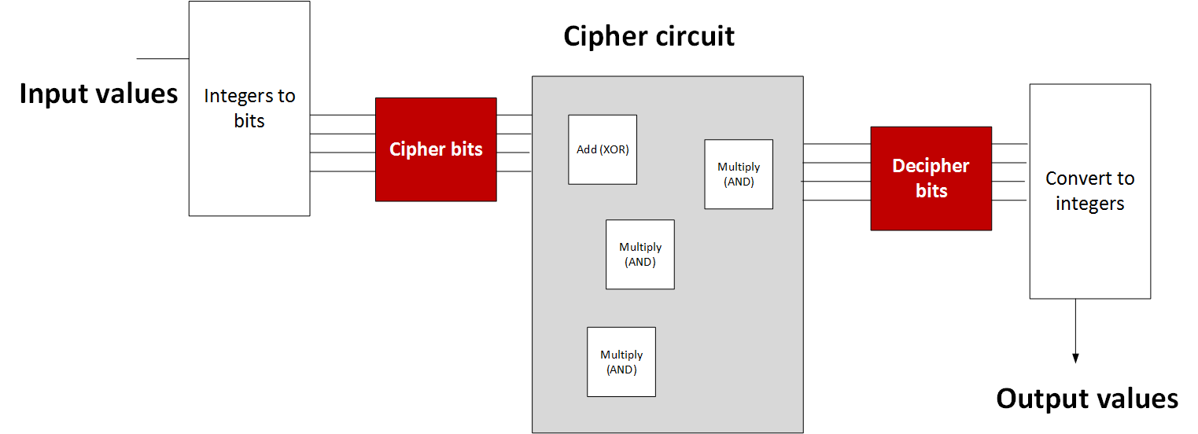
Full Homomorphic Encryption - DGHV (Dijk, Gentry, Halevi and Vaikuntanathan

Slide 35
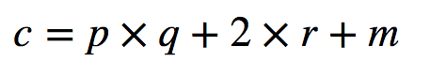
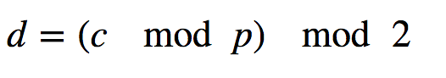
Full Homomorphic Encryption - DGHV (Dijk, Gentry, Halevi and Vaikuntanathan

Slide 36
Next Generation Crypto
Light-weight crypto.
Quantum-robust crypto
Tokenization.
Zero-knowledge.
Homomorphic Encryption.
zkSnarks, Range-proofs
Prof Bill Buchanan OBE http://asecuritysite.com/zero

Slide 37
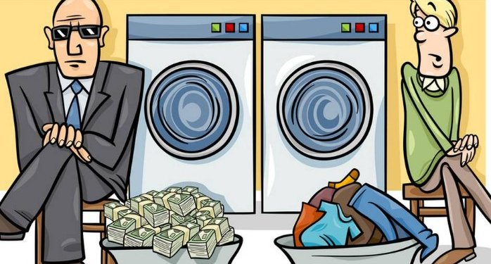
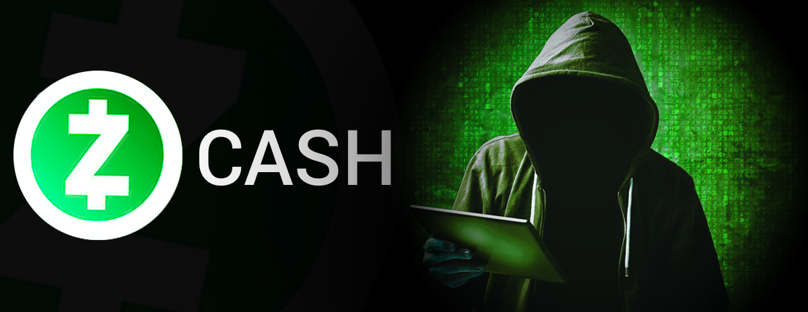
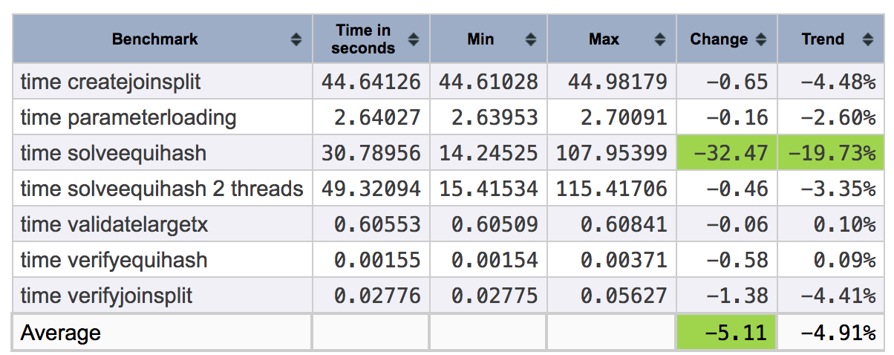
zCash
Zcash uses ZKP
Humans that were at fault with a new Zcoin hack (Zcash) and which involved making transactions of £561,000 ($699,000), and with an associated profit of £349,000 ($435,000).
It happened with a single additional character in the source code, and allowed the creation of a Zerocoin spend transaction, and which was able to extract 370,000 Zcoins.
zk-SNARK stands for “Zero-Knowledge Succinct Non-Interactive Argument of Knowledge,”

Slide 38

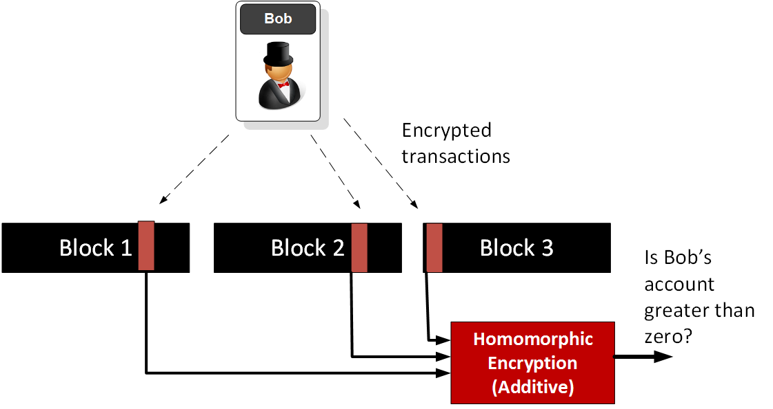


Zero-knowledge Proofs
zk-SNARK stands for “Zero-Knowledge Succinct Non-Interactive Argument of Knowledge,”
Pal
Link

Slide 39


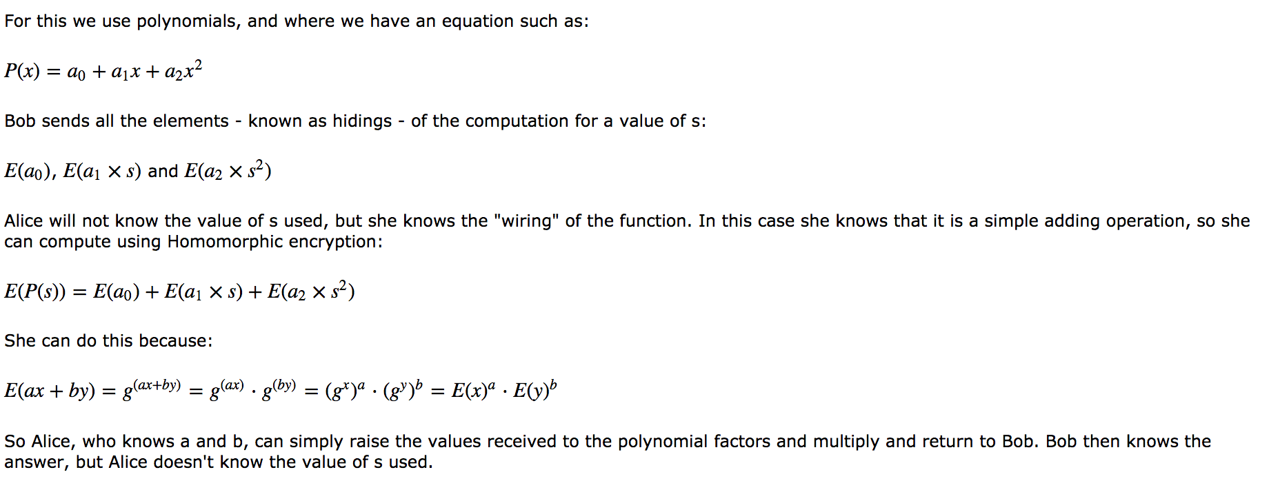




zkSNARK
Hidden Homomorphic
With HH we aim to prove that Alice knows two values (x, y) to equal a given answer (ans)
Let's say you want to prove that Alice can produce two number which adds up to 8. Overcomes the major problem of Blockchain - which is the lack of privacy in computations and transactions.
Blind Evaluation
Bob doesn't want Alice to known the values that he is using and Alice doesn't want Bob to know the method she is using to compute a result

Slide 40
Next Generation Crypto
Light-weight crypto.
Quantum-robust crypto
Tokenization.
Zero-knowledge.
Homomorphic Encryption.
zkSnarks, Range-proofs
Prof Bill Buchanan OBE http://asecuritysite.com/zero

Slide 41

Public and private keys with ECC
Private key: 0xc9f4f55bdeb5ba0bd337f2dbc952a5439e20ef9af6203d25d014e7102d86aaeeL
Public key: 0xc44370819cb3b7b57b2aa7edf550a9a5410c234d27aff497458bbbfec8b6a327, 0x52a1a3e222cd89cbd2764b69bd9b0ea5c4fd6ca28861e1f2140eeff9c2e76487
G: (5066263022277343669578718895168534326250603453777594175500187360389116729240L, 32670510020758816978083085130507043184471273380659243275938904335757337482424L)

Slide 42





Pedersen Commitment and Mimblewimble

Slide 43


Range Proof
With bulletproofs, we can ask our financial institutions to prove that they have liquidity … “Prove that you have more than $1 billion of liquidity”, and if they failed to prove this, we would quickly move to audit them. Fraud on a large-scale basis would thus be detected in seconds.
Monero has seen an 80% reduction in transaction size, and which has also led to a significant reduction in the transaction fees.
Bob is applying for a loan from Alice, and now needs to prove that he has a salary of between $60,000 and $100,000, and that his employer — Trent — has at least $1million in the bank … merged into a single (and short) bullet proof
Significant reduction in the size of the signature as opposed to other CT methods (such as zk-SNARKs and zk-STARKs).
Significantly reduced transaction fees with shorter signatures.
Supports MPC (Multiparty Computation) and where many parties can come together to create a single range proof, without revealing their secrets.
Allow for the aggregation of range proofs and produces a single, and short, signature.
Fast verification of proofs (and which are faster than most range proof methods, but still slower than zk-SNARKs).
Design to be setup for blockchain integration.
No need to setup a trust infrastructure. This often involves creating an initial set of encryption keys which are then used for trusted signatures. These keys should be used only once, and then deleted. If these keys are not deleted, there is a risk to future trustworthiness of the whole infrastructure.

Slide 44
IPFS
Light-weight crypto.
Quantum-robust crypto
Tokenization.
Zero-knowledge.
Homomorphic Encryption.
zkSnarks, Range-proofs IPFS
Prof Bill Buchanan OBE http://asecuritysite.com/zero

Slide 45



IPFS
IFPS

Slide 46
Next Generation Crypto
Light-weight crypto.
Quantum-robust crypto
Tokenization.
Zero-knowledge.
Homomorphic Encryption.
zkSnarks, Range-proofs
Prof Bill Buchanan OBE http://asecuritysite.com/encryption

